Slide 1



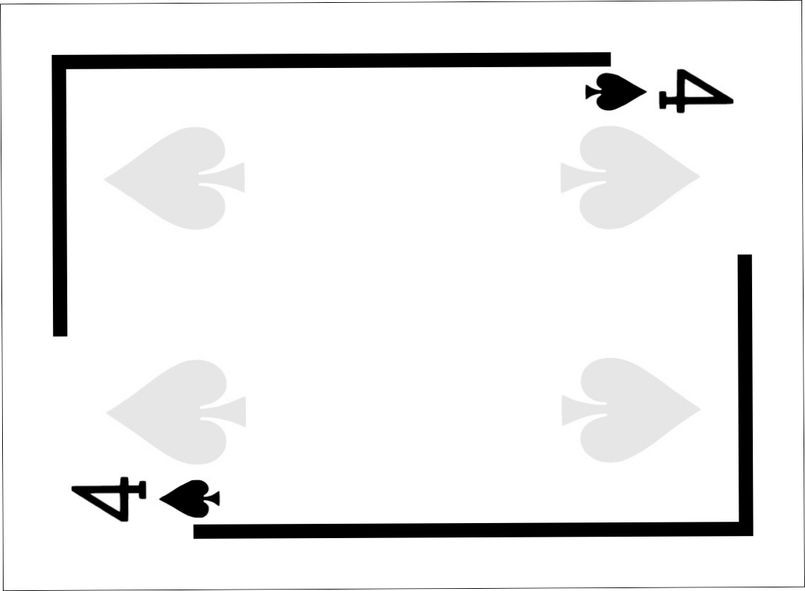
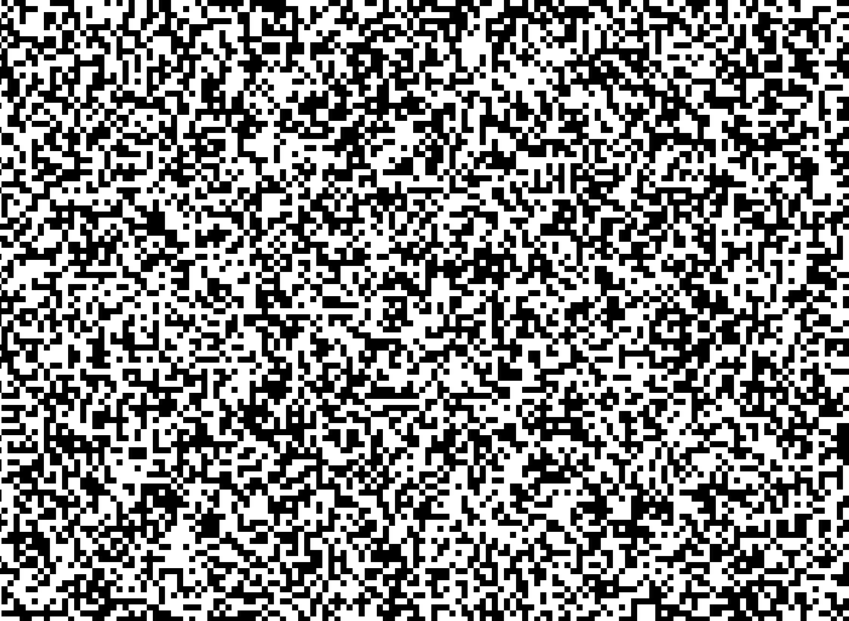

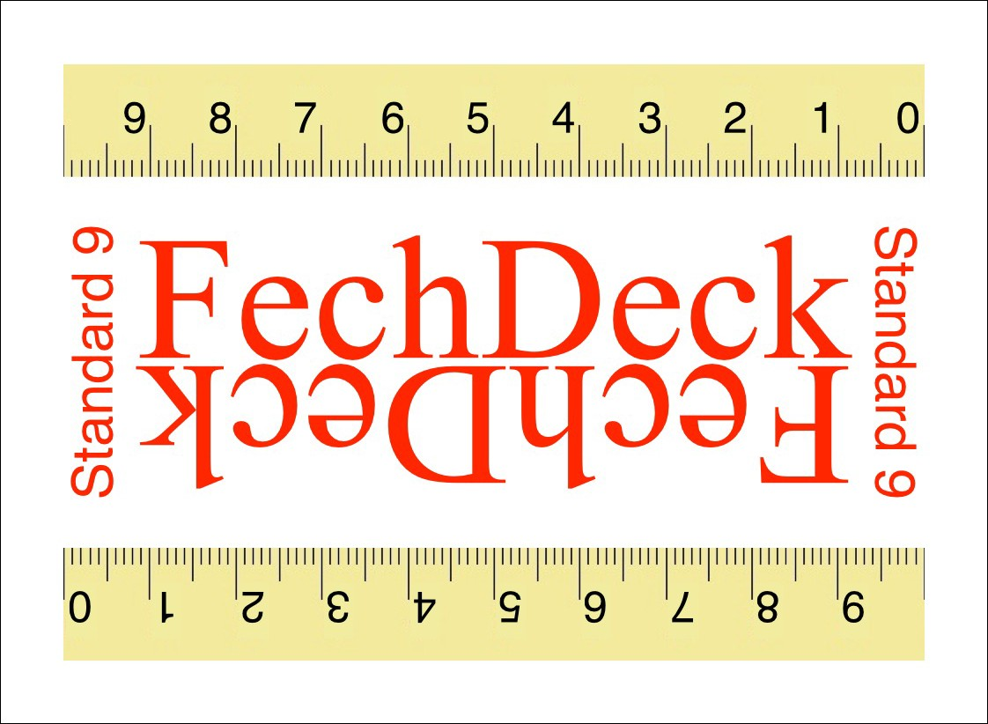




Method of adjustment
1. Select cards Ace (1)-6 of all suits.
6. Note the horizontal line length from the top ruler on the Joker and the vertical line length from the number on the face of the test card.
2. Shuffle the selected cards and place the stack face down on the table.
3. Select the top card as the test card and turn it face up, place one of the Jokers on top face down.
7. Enter the result in the appropriate box in the spreadsheet.
8. Repeat steps 3-7 for the other cards.
4. Holding the cards horizontally, slide the Joker back and forth until the horizontal line on the test card appears to be the same length as the vertical line.
9. Repeat steps 2-7 until the desired number of trials have been completed
10.Analyze the data using the spreadsheet.
5. Hold the cards in place and turn them over.

Slide 2
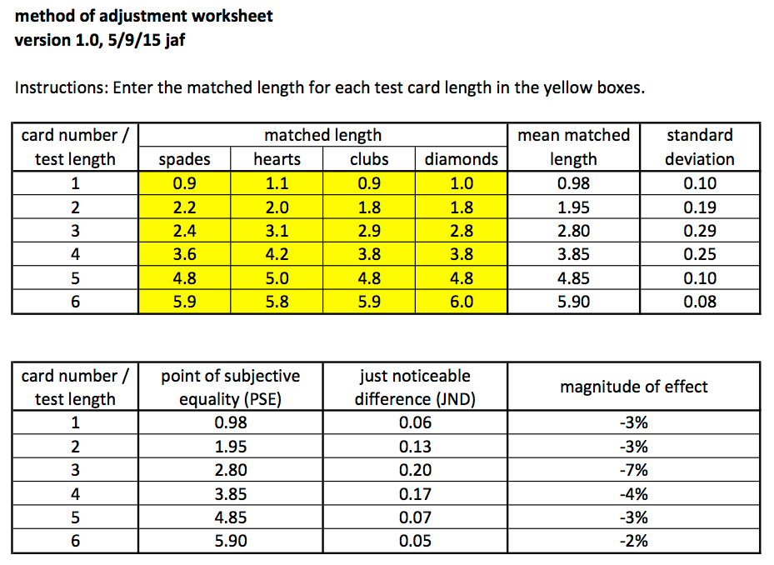
Method of adjustment analysis

Slide 3
Method of Adjustment Exercise
Get comfortable with making judgments
Download to Desktop and rename spreadsheets
  YourLastName-adjustment-vertical
  YourLastName-adjustment-horizontal
Half-class will do vertical first and other half will do horizontal first.
Email the spreadsheets to yourself when done
Email me the card number-magnitude of effect pairs for vertical and horizontal methods
The question is whether orientation matters

